Slide 1
Radiation Test Board Summary
Capstone Team 40: Aaron Ganus, Kenneth Chen, and Stanley Lee
Texas Instruments Mentor:
Meredith McKean
Notes:
Kenneth

Slide 2
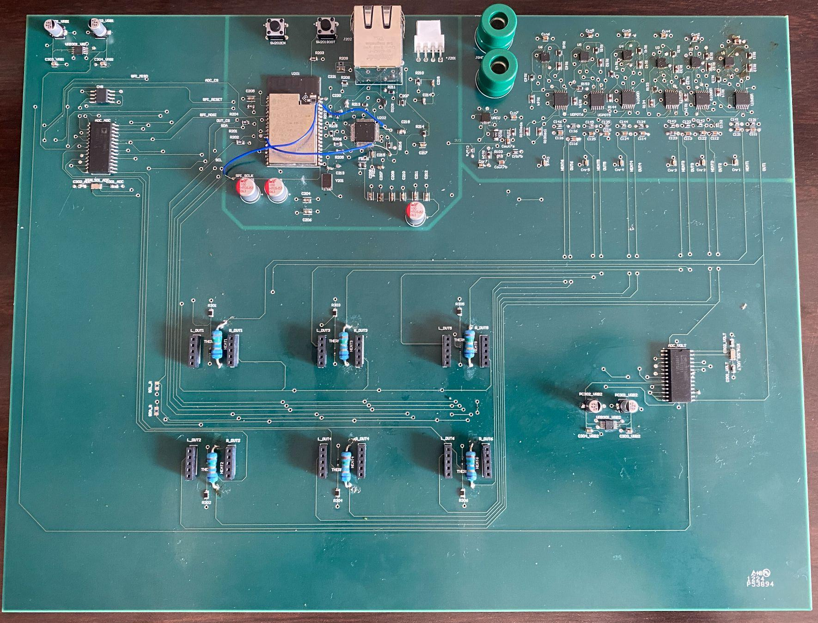
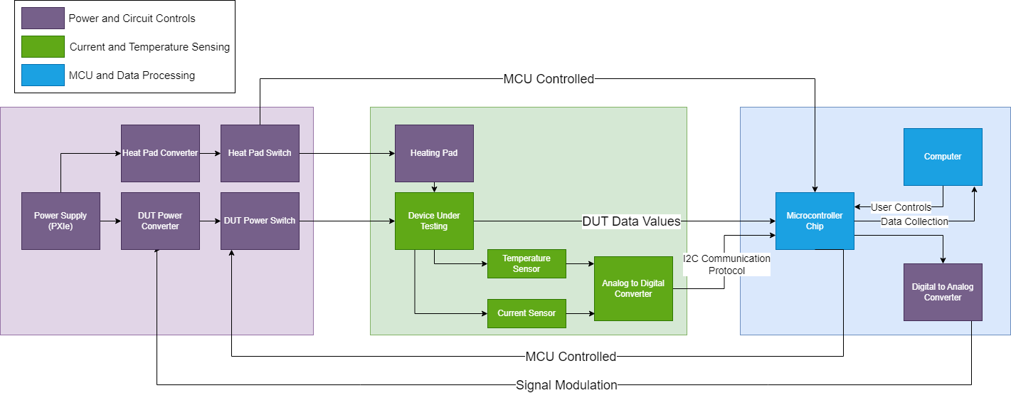
Proposed Solution
A radiation test board capable of holding and monitoring multiple test devices without the need for personnel to physically swap out components between tests.
The Cyclotron test platform the test board sits on is can be remotely controlled from the monitoring room, allowing each DUT to be moved into the path of the beam. Each DUT and its heating pad will be powered as needed via a switching mechanism.
Notes:
Aaron

